Slide 1
3 REST API

Slide 2
3.1 REST Introduction

Slide 3
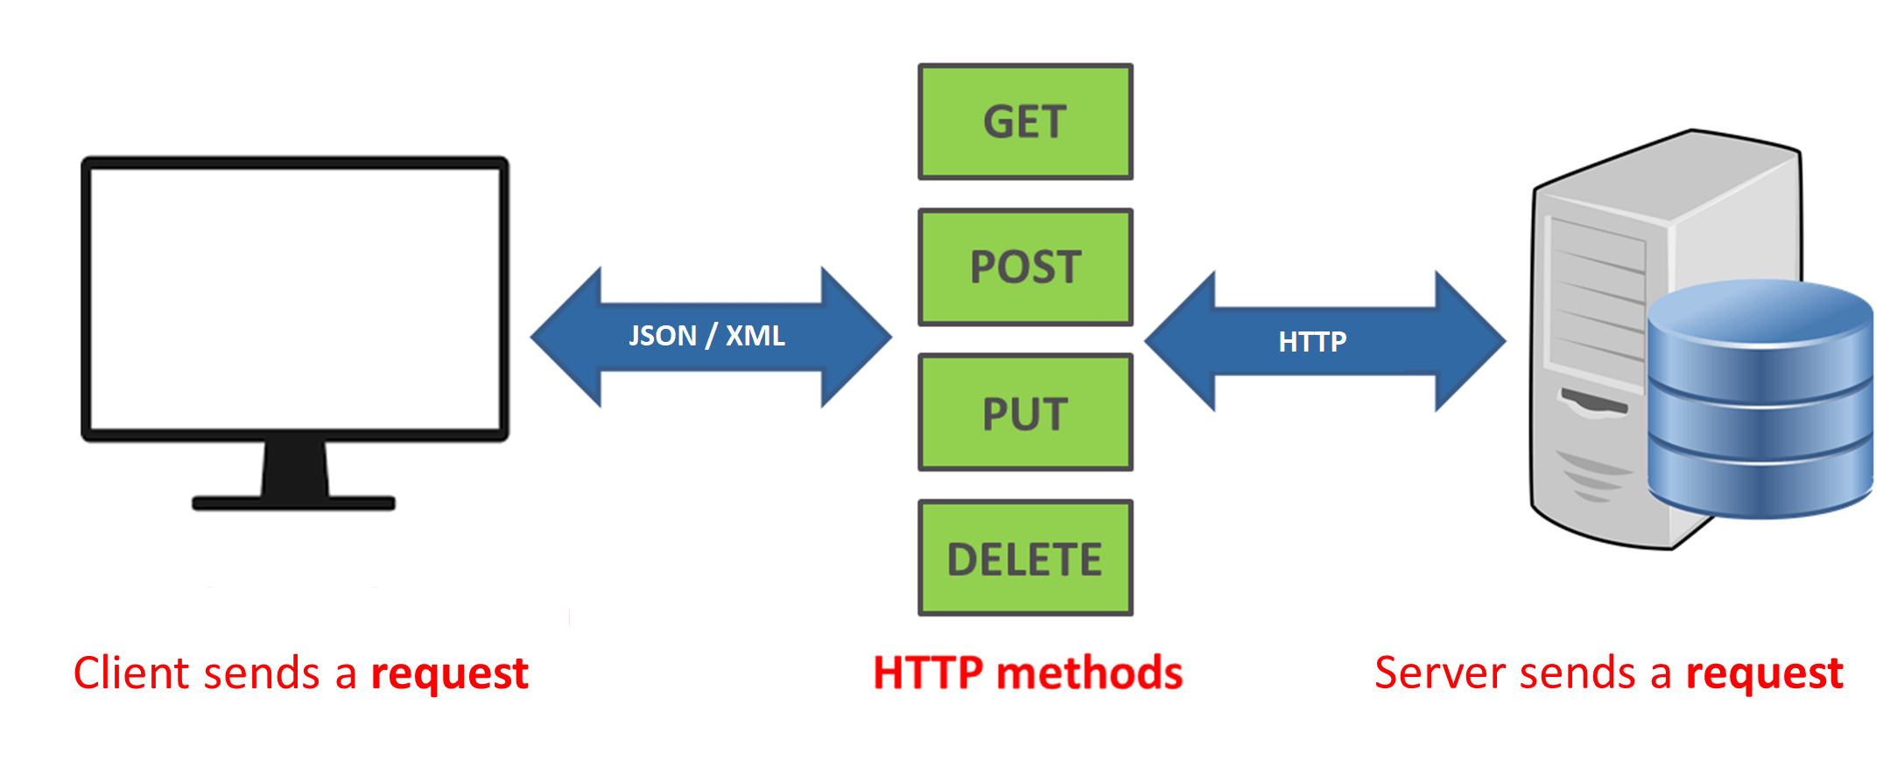
REST INTRODUCTION
What is REST?
REpresentational State Transfer (REST) is an architectural style that defines a set of constraints to be used for creating web services. REST API is a way of accessing the web services in a simple and flexible way without having any processing. All communication done via REST API used only HTTP request.

Slide 4
REST API
REST – stands for Representational State Transfer.
It is a set of functions to which the developers performs requests and receive responses.
In REST API interaction is made via HTTP/HTTPS protocol.
REST also allows computers to talk to each other over a network.
It involves using HTTP methods to send and receive messages, and does not require a strict message definition, unlike Web services.
REST messages often take the form of XML, or JavaScript Object Notation (JSON).

Slide 5
3.2 REST Architecture

Slide 6



Rest based architecture
API
Business Logic

Slide 7
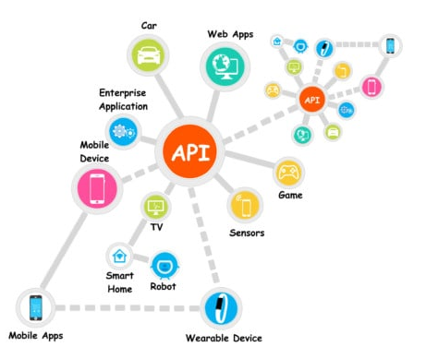
API Uses

Slide 8
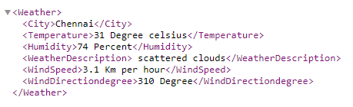
Rest Architectural Elements
Rest Architectural style defines parts of Restful service as key conceptual elements.
Resource : Information stored on a Server, which can be requested by a client.
Resource Identifier (URI) : Every Resource on the Server needs to be uniquely identifiable. To do that every resource has a unique URL that can be used to get to that Resource.
http://restapi.demoqa.com/utilities/weatherxml/city/chennai
Representation & Representation Metadata: A resource is the actual data. Now this data can be represented as an XML, HTML or may be simple text.
URI
Representation
Resource

Slide 9
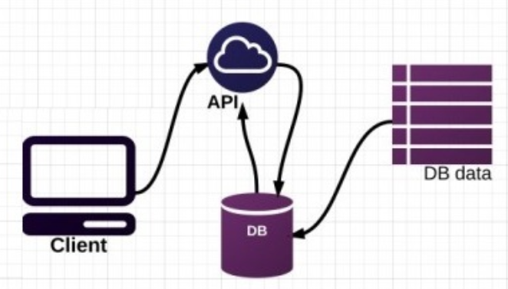
REST exposes database as a service

Slide 10
3.3 REST Assured

Slide 11
REST Assured
What is Rest Assured?
Rest Assured is one of the most powerful libraries for testing RESTful API using Java language. This should be the first-choice when you need to test a REST.
The framework sends a network request to an application under test and verifies the response based on the expectations.
Features:
Supports HTTP methods.
Supports for BDD.
Use of Hamcrest matches for checks.
Use of Gpath for selecting element from JSON response.
Permits:
Format the HTTP request.
Send it over a network.
Validating HTTP status code of an request
Finally validating response data.
It also handles various authentication mechanism (Basic Authentication / OAuth/Certificates).

Slide 12
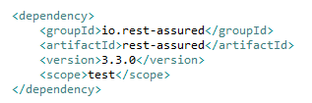
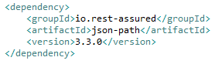
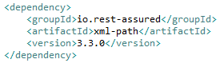
Configuring REST Assured
Maven dependency of Rest Assured

Slide 13
3.4 REST Testing Tools

Slide 14

Growing list of REST testing tools

Slide 15
3.5 REST Test Flow

Slide 16
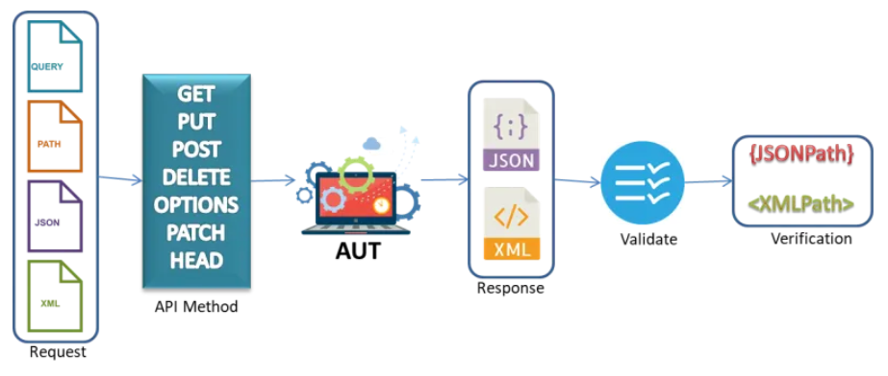
REST Test Flow Diagram

Slide 17
3.6 REST HTTP Methods

Slide 18
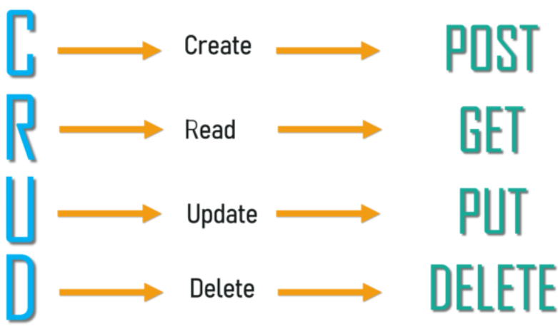
REST support CRUD

Slide 19
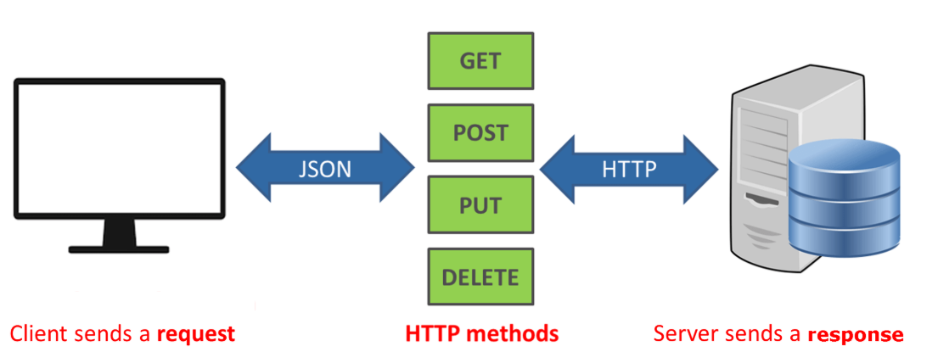
Rest in action
GET | Retrieves data from a remote server. It can be a single resource or a list of resources.
POST | Creates a new resource on the remote server. *
PUT | Updates the data on the remote server.
DELETE | Deletes data from the remote server.

Slide 20
HTTP Methods for RESTful Services
HTTP Verb | HINT | Response Code
POST | The POST verb is most-often utilized to create new resources. | 201 (Created), 404 (Not Found), 409 (Conflict) .
GET | The HTTP GET method is used to read (or retrieve) a representation of a resource | 200 (OK)
PUT | PUT is most-often utilized for Update/Replace capabilities | 200 (OK), 204 (No Content). 404 (Not Found, 405 (Method Not Allowed)
PATCH | PATCH is used for modify capabilities | 200 (OK), 204 (No Content). 404 (Not Found, 405 (Method Not Allowed)
DELETE | It is used to delete a resource identified by a URI. | 200 (OK) , 404 (Not Found, 405 (Method Not Allowed)

Slide 21
10 Most Common Response Codes
Code | Message | Description
200 | OK | The data was received and the operation was performed.
201 | Created | The data was received and a new resource was created. The response needs to return the data in the payload.
204 | No content | The operation was successful but no data is returned in the response body. This is useful when deleting a resource.
301 | Moved permanently | This and all the future requests should be redirected to a new URL.
302 | Moved temporarily | The resource moved temporarily to another URL.
400 | Bad request | The server cannot accept the request because something is wrong with the client or the request that it sent.
403 | Forbidden | The client is not allowed to use the resource.
404 | Not found | The computer is not able to find the resource.
405 | Method not allowed | For example, when sending a DELETE request to a server that doesn't support the method.
500 | Internal server error | Service unavailable due to error on the server side.

Slide 22
3.7 REST Authentication And Challenges

Slide 23
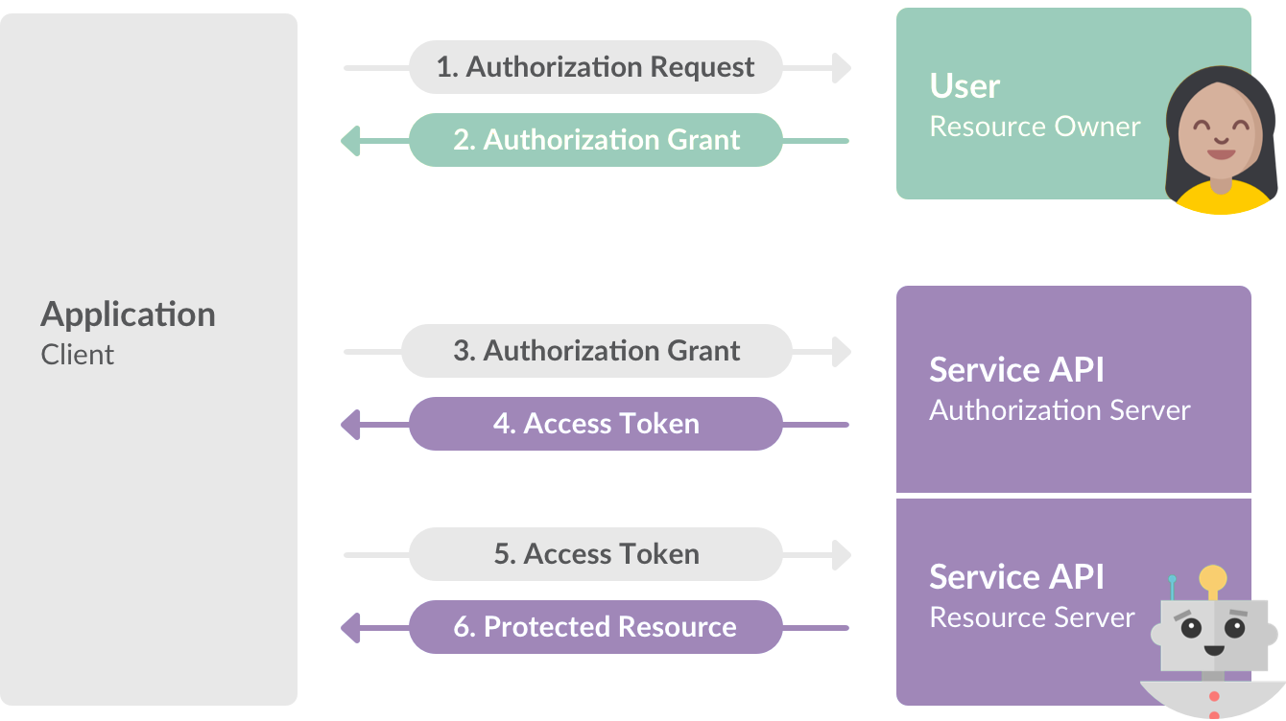
OAuth authentication

Slide 24
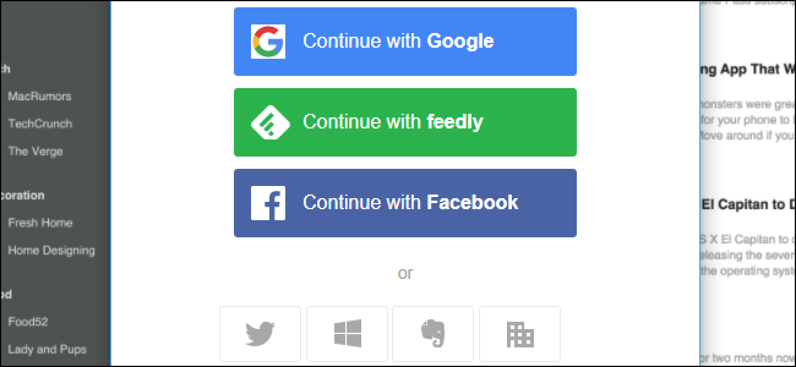
OAuth authentication

Slide 25
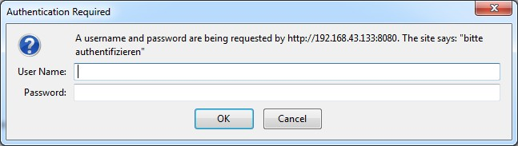
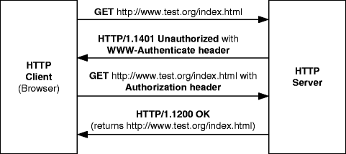
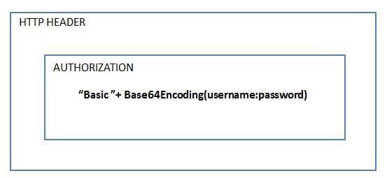
Challenges

Slide 26
3.8 Hamcrest Mathers

Slide 27
Hamcrest Matchers
Hamcrest is a framework for software tests. Hamcrest allows checking for conditions in your code via existing matchers classes.
To use Hamcrest matchers use the assertThat statement followed by one or several matchers.
For example: assertThat(actual, equalTo(expected));
Refer : http://hamcrest.org/JavaHamcrest/javadoc/1.3/org/hamcrest/Matchers.html

Slide 28
3.9 API Test structure for Projects

Slide 29
API Test structure for Projects
Test Suite(s) (Smoke, Sanity, Regression, Functional, Performance, Security)
Test cases
Test Steps
Connect to API with necessary authentication inputs and retrieve the session ids
Use the session ids in all the subsequent requests
Perform some get operation(s) and assert response codes for each of the above responses
Perform some post operations(s) and assert response codes
Use data driven approach to achieve high coverage

Slide 30
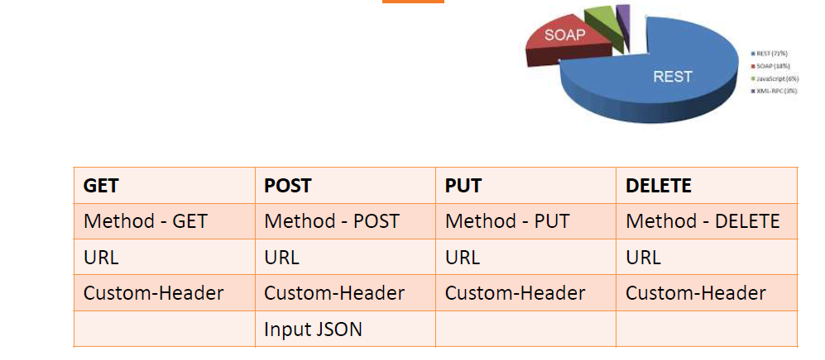
API Inputs

Slide 31
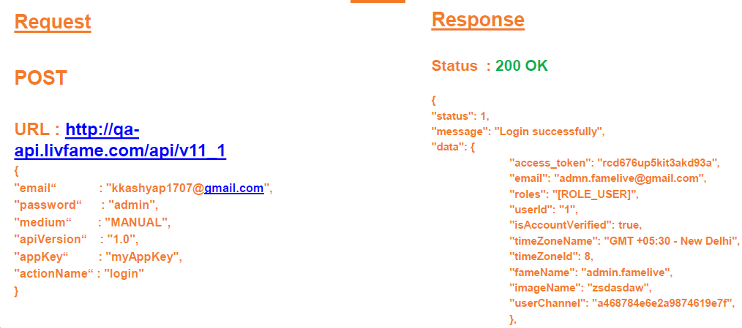
Sample HTTP Method

Slide 32
Thank You

